Slide 1






Your Voice Matters. Don’t Let AI Drown It Out
Milestone 4
Ângela Ribeiro (109061)
João Santos (110555)
João Viegas (113144)
Hugo Castro (113889)
Ana Rita Silva (114220)
Advisors:
Prof. João Rafael Almeida
Vicente Barros
Notes:
ugo
2ª Milestone
Elaboration Phase
BotBlocker

Slide 2

PROJECT OVERVIEW
BotBlocker is a browser extension and website that uses community intelligence to identify and block automated social media profiles.
2

Slide 3

TABLE OF CONTENTS
01
Introduction and Motivation
02
The State of Related Work
03
Architecture
04
Technical Details
05
Implemented Features
3
Notes:
ugo

Slide 4
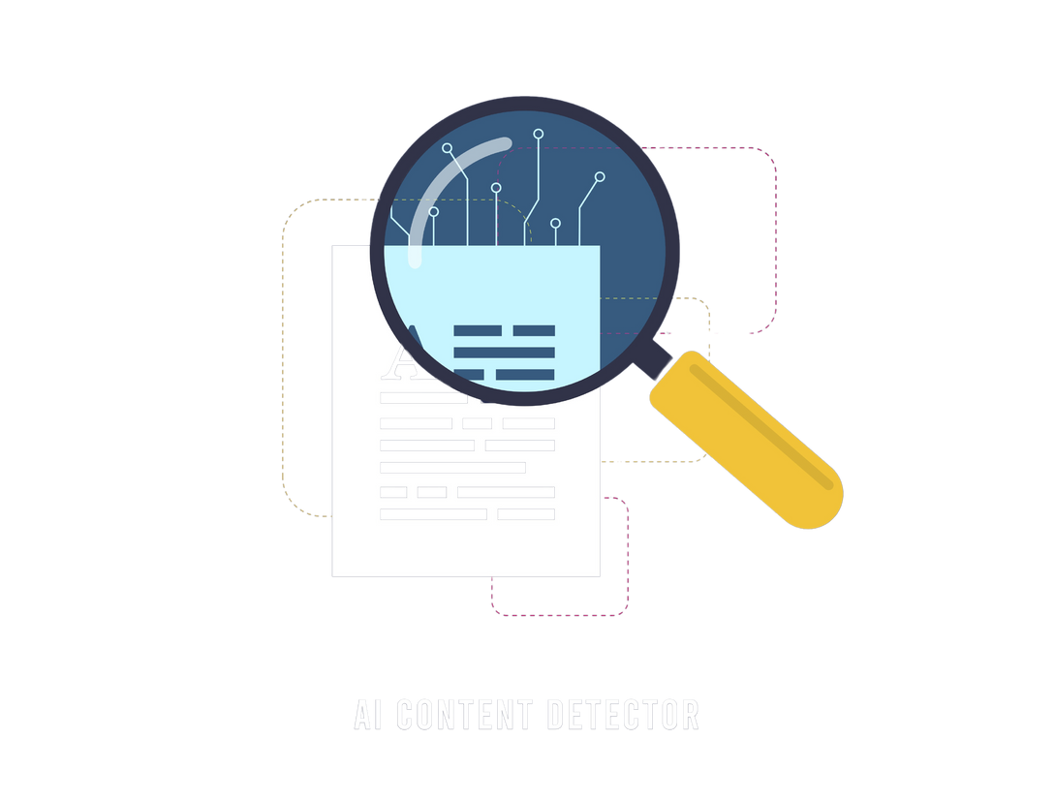
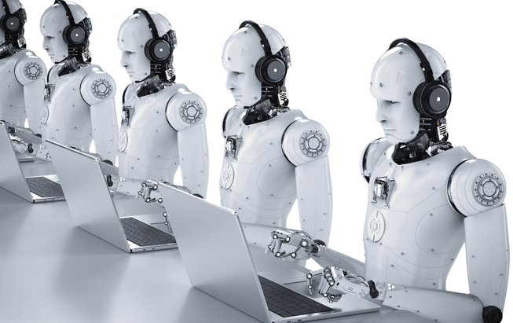

INTRODUCTION AND MOTIVATION
Detection and Blocking
AI Bots
Website + Extension
Manipulating engagement and spreading misinformation.
Detect and block interactions with AI profiles.
Identifying AI-driven accounts for transparency.
4
Notes:
ugo
presença de bots nas redes sociais
website+extensão
detectar e bloquear
recolha de requisitos, arquitetura
eficaz, fácil

Slide 5
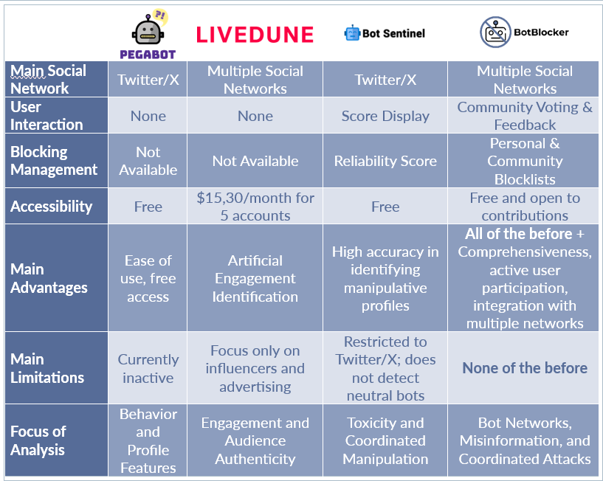
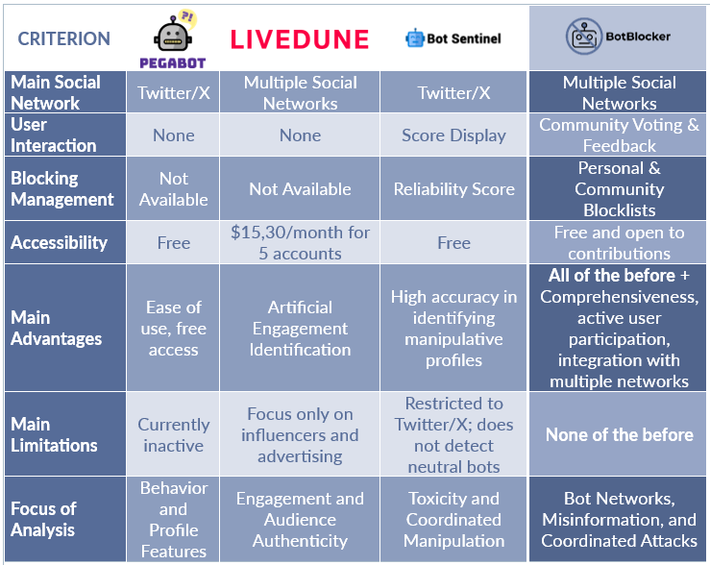

THE STATE OF RELATED WORK
5
Notes:
viegas

Slide 6
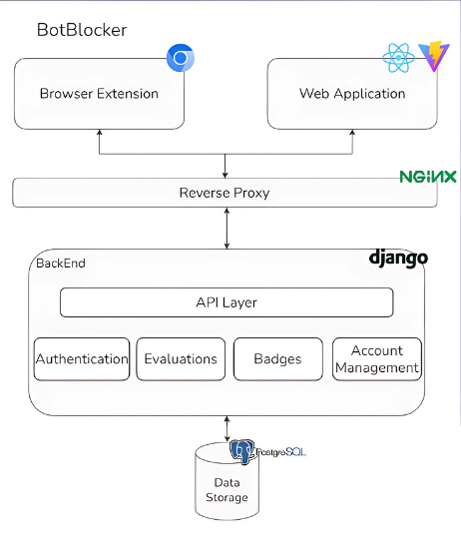
ARCHITECTURE
6
Notes:
joão carlos

Slide 7
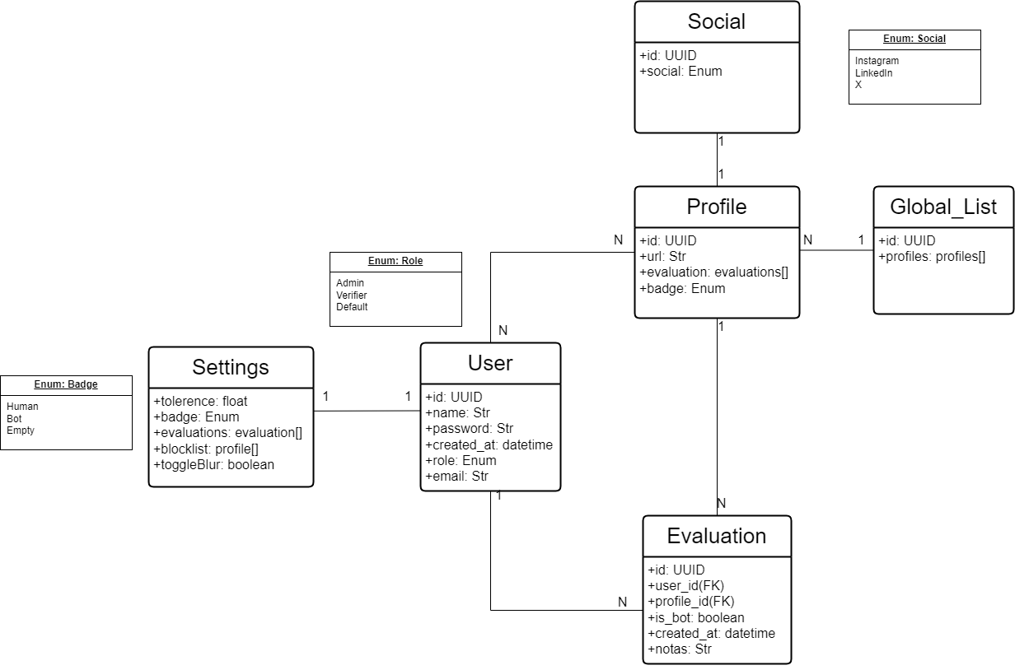

DOMAIN MODEL
7
Notes:
joão carlos

Slide 8


TECHNICAL DETAILS
Modular & Extensible
Frontend and browser extension built with React and JSX
Backend developed with a RESTful API
Clean, modular codebase – easy to maintain and extend
Designed to support multiple social platforms
API logic and UI components are decoupled
Local-First Design
Works without login: data is stored locally
Optional login enables syncing blocklists and preferences across devices
Sync handled via custom backend with session-based authentication
8
Notes:
viegas

Slide 9
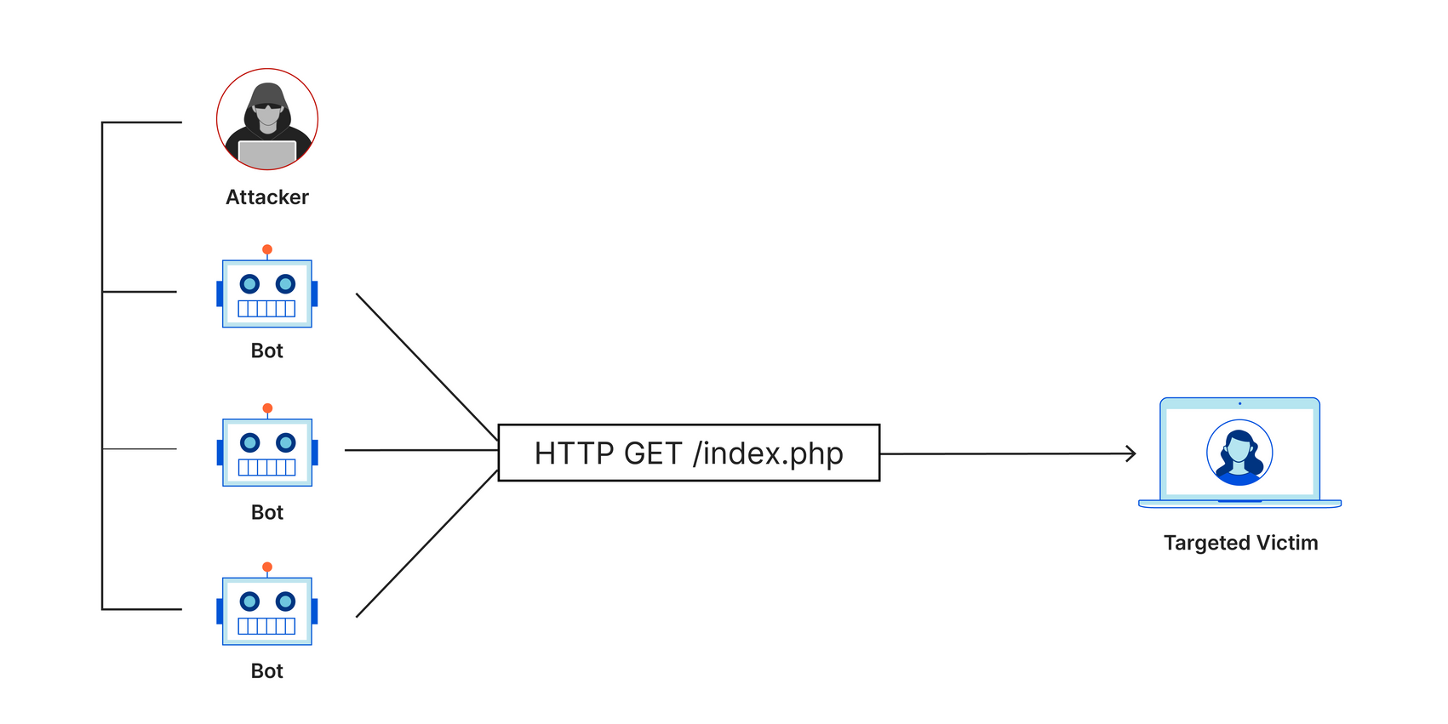
TECHNICAL DETAILS
Spam Voting Protection
Admins and verifiers monitor abnormal voting patterns
Account blocking and timeouts reduce spam voting risks
Web Sockets usage
SPAM VOTING
9
Notes:
viegas

Slide 10

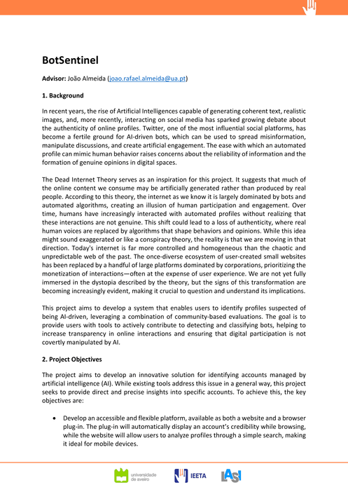
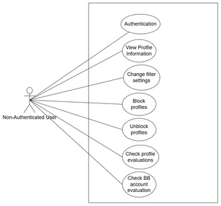
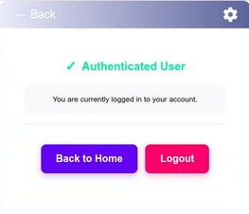
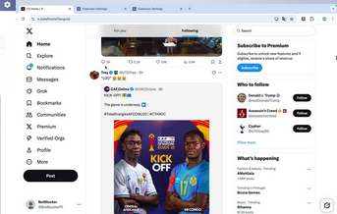
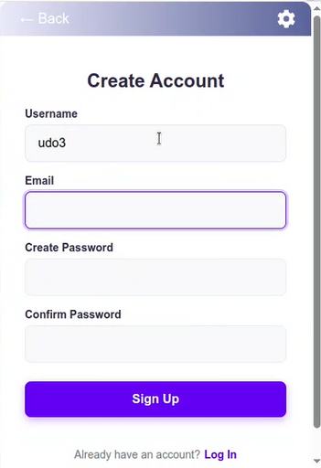
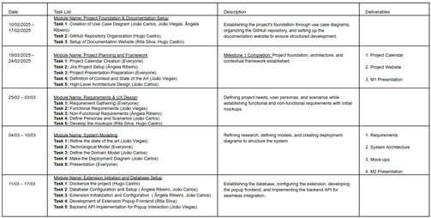

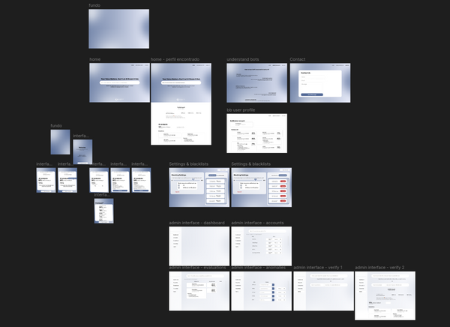
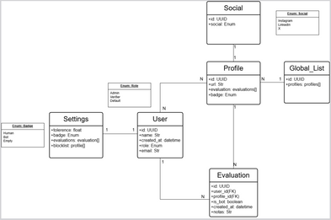

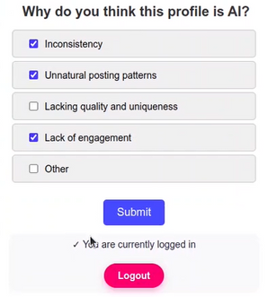
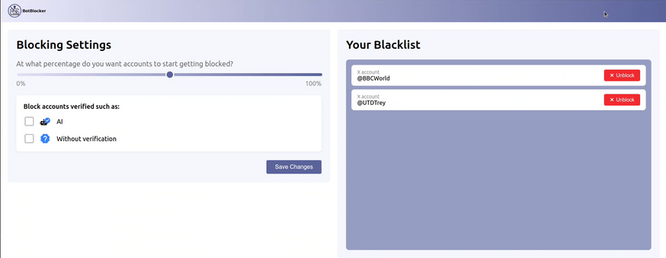
IMPLEMENTED FEATURES
M1
M2
Checkpoint 1
Checkpoint 2
10
Notes:
Contexto do projeto - problema central
Objetivos claros
Estado da arte
Mockups
Repositório GitHub
Calendário do projeto

Slide 11
IMPLEMENTED FEATURES
M1
M2
Checkpoint 1
Checkpoint 2
11
Notes:
Requisitos funcionais e não funcionais
Personas e cenários
Mockups
Arquitetura do sistema
Implementação: dockerização, BD, frontend e backend

Slide 12
IMPLEMENTED FEATURES
M1
M2
Checkpoint 1
Checkpoint 2
12
Notes:
Login
Bloqueio manual de perfis
Extração e bloqueio da timeline
Personal settings

Slide 13
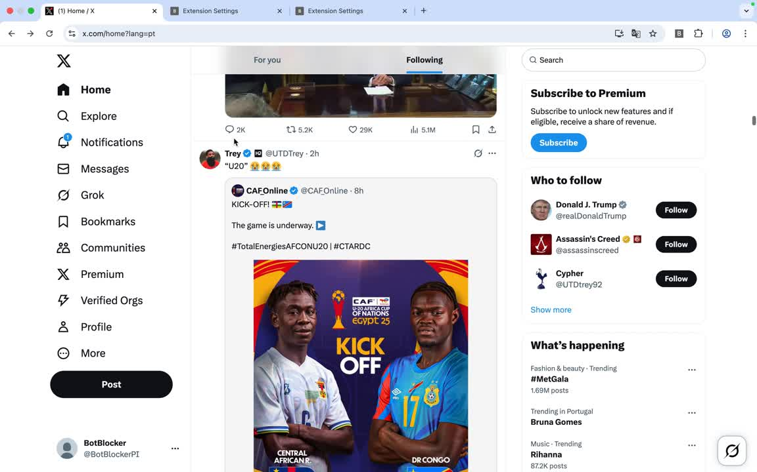
IMPLEMENTED FEATURES
M1
M2
Checkpoint 1
Checkpoint 2
13

Slide 14
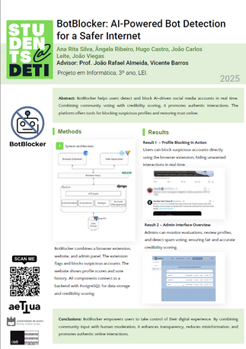
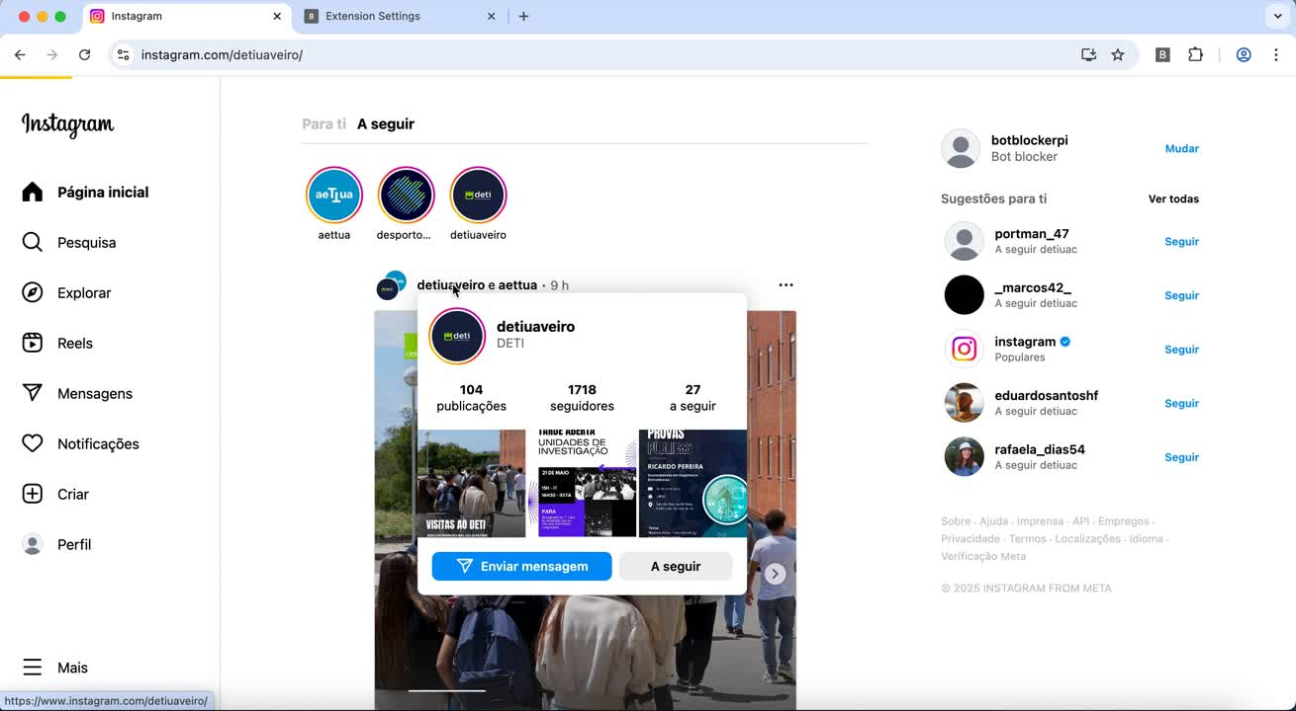
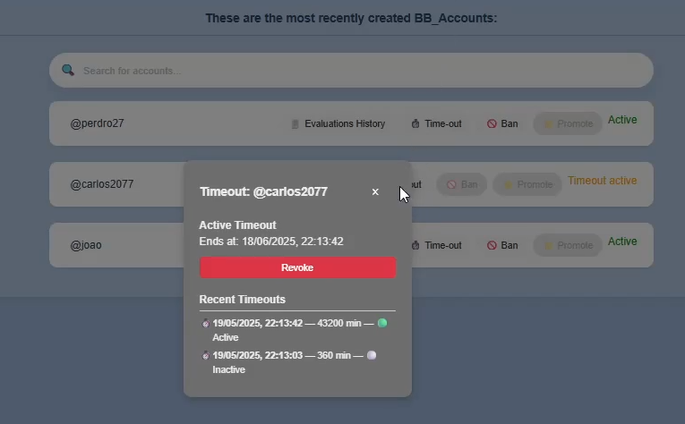
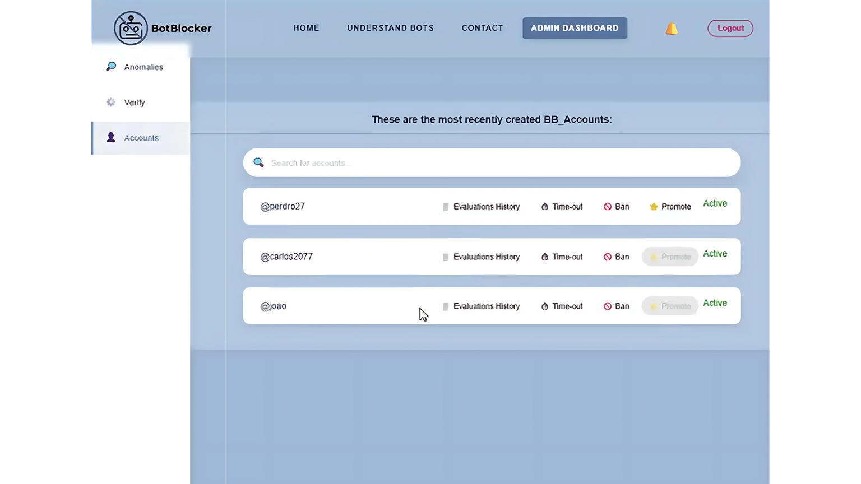

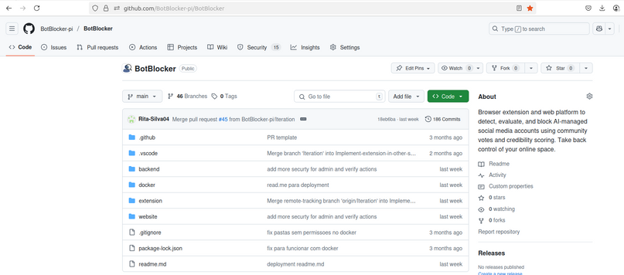
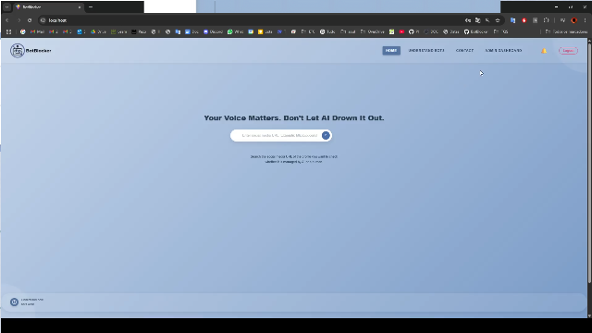
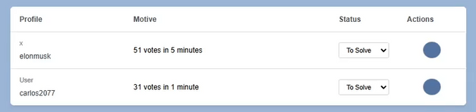
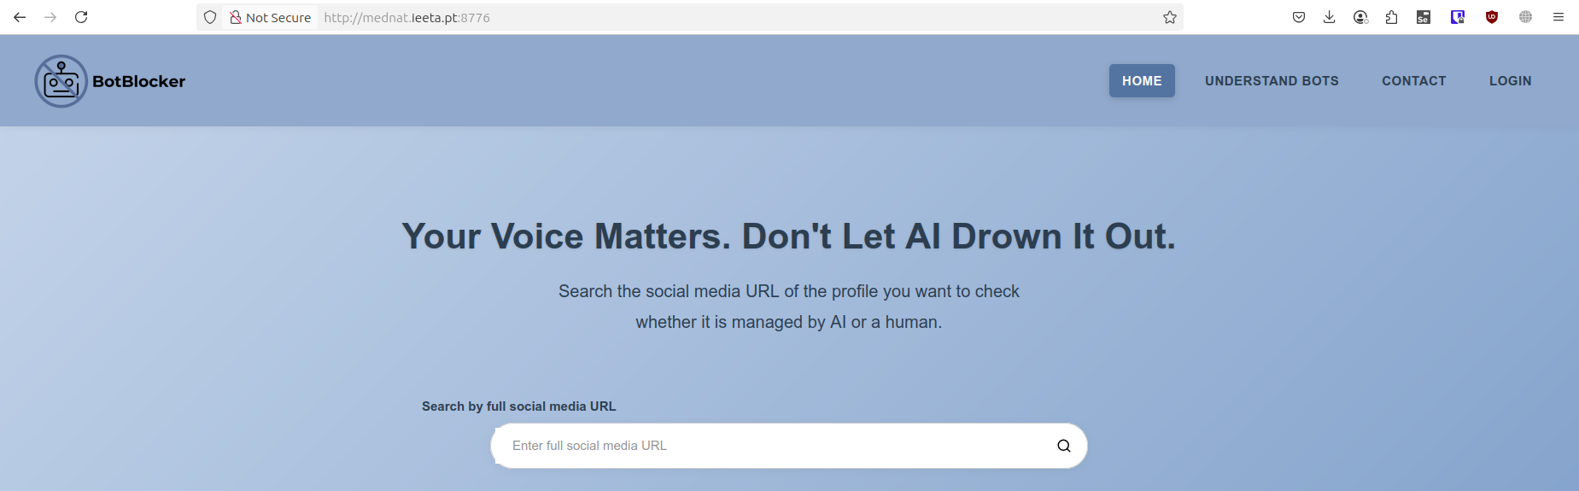
IMPLEMENTED FEATURES
M3
Checkpoint 3
M4
14

Slide 15
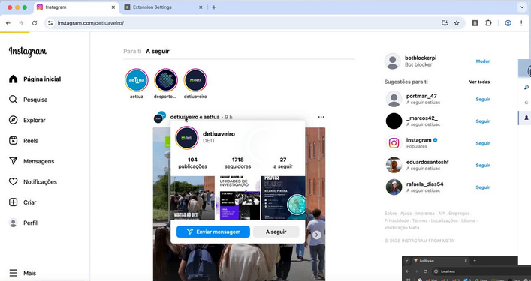
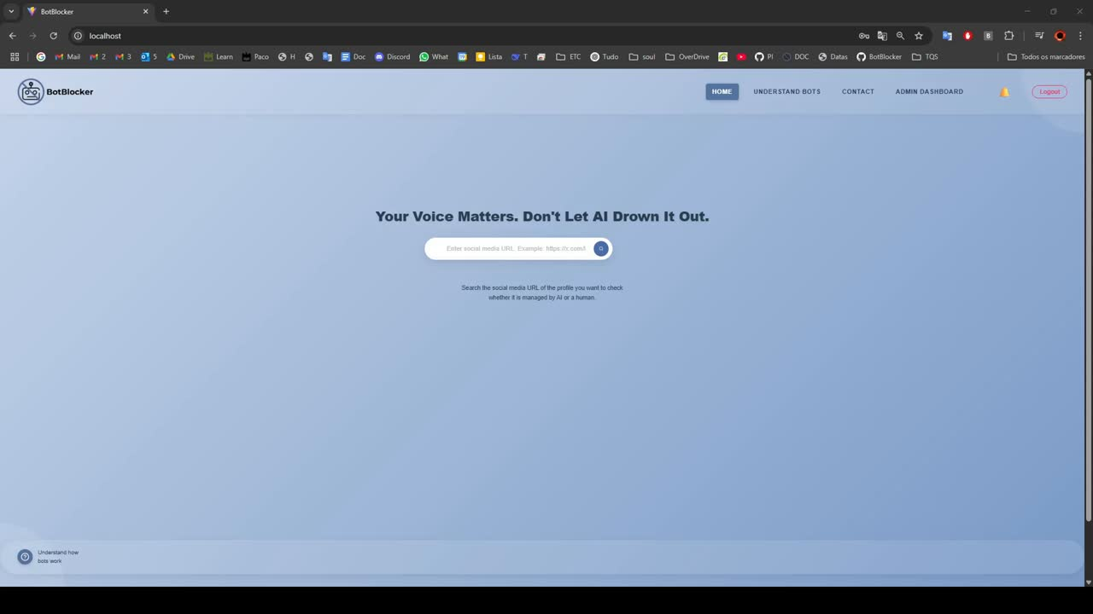
IMPLEMENTED FEATURES
M3
Checkpoint 3
M4
15
Notes:
ugo
Mockups
extensão e website

Slide 16
IMPLEMENTED FEATURES
M3
Checkpoint 3
M4
16
Notes:
ugo
Mockups
extensão e website

Slide 17
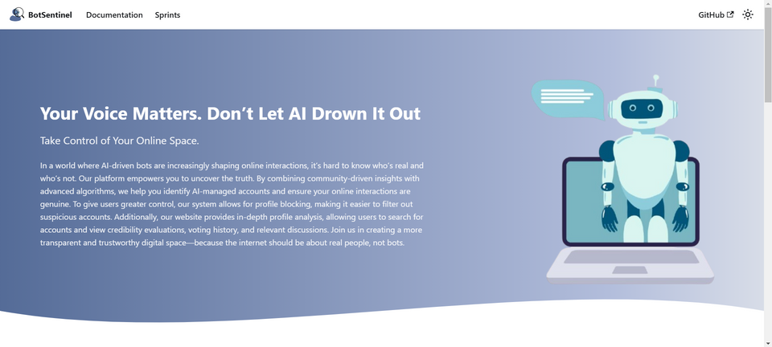

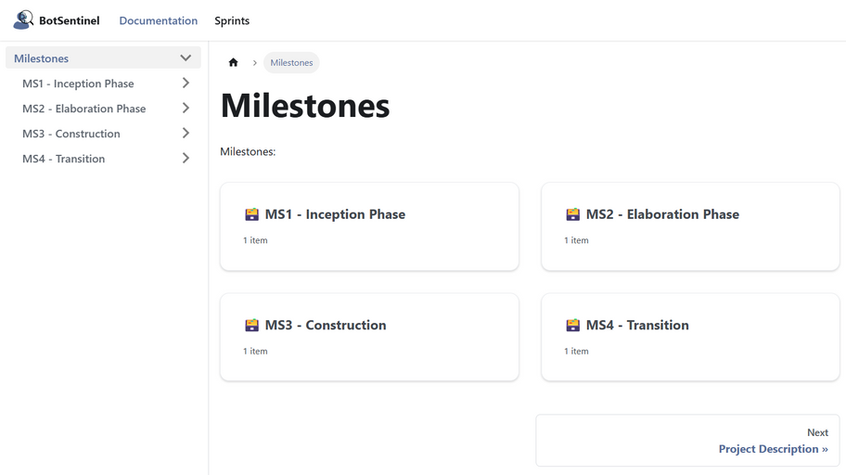
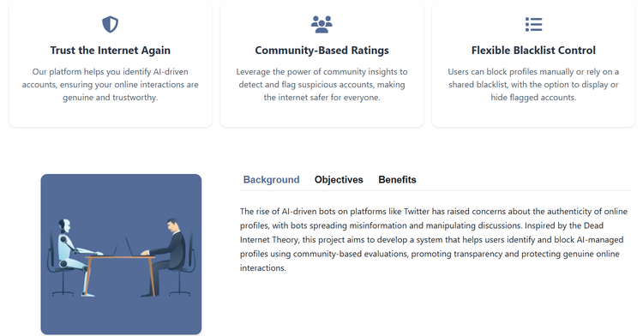
Thank you!
https://botblocker-pi.github.io/Documentation/
17
Notes:
ângela

